Slide 1
Gender Pay Gap
MGMT 59000 Visual Analytics
Group 3
Dounia Theoni | Pratyusha Reddy Midudhula | Duy Truong Nguyen
Ritik Khandelwal | Pratiksha Gupta | Hassan Abrar
10/05/2023

Slide 2
Introduction
Introducing Gender Pay Gap
Gender pay gap is a systemic issue.
Rooted in societal perceptions of the value of women's work.
These perceptions influence career choices and opportunities.
Women often directed towards lower-paying roles.
Assumptions about women's roles impact pay disparities.
Historical views shape how women's work is valued.
Gender bias affects choices and opportunities.
Supported by research on the gender pay gap.

Slide 3
Objectives & Goals
What we hope to gain out of this project
Our focus is on global progress in race, diversity, and gender equality.
We'll examine historical trends and current developments.
We'll explore the efforts of companies striving for gender equality by 2030.
Our primary focus is on the persistent gender pay gap.
Key questions we aim to answer:
Question 1
Are compensation disparities based on gender, education, race, or occupation?
Question 2
How does pay change with age and professional experience for men and women?

Slide 4
Data Collection
Kaggle as our primary data source
UK Gender Pay Gap Data 2018 to 2021
Specifically focused on the Gender Pay Gap in the United Kingdom.
Promote transparency and accountability regarding pay disparities based on gender.
The dataset covers the years 2017 to 2020
Each of the 4 files is in Excel format and has 25 columns and 3000 rows.
Glassdoor Gender Pay Gap Analysis Dataset
Analyze gender pay gap trends on Glassdoor, a popular job and company review platform.
The data pertains to gender pay disparities across European geography
The file is in Excel format and has 9 columns and 1000 rows
Why we chose these ?
Apart from being from credible sources, the datasets seemed actionable in terms of visual representations
The data is comprehensive, which can potentially give insights .

Slide 5
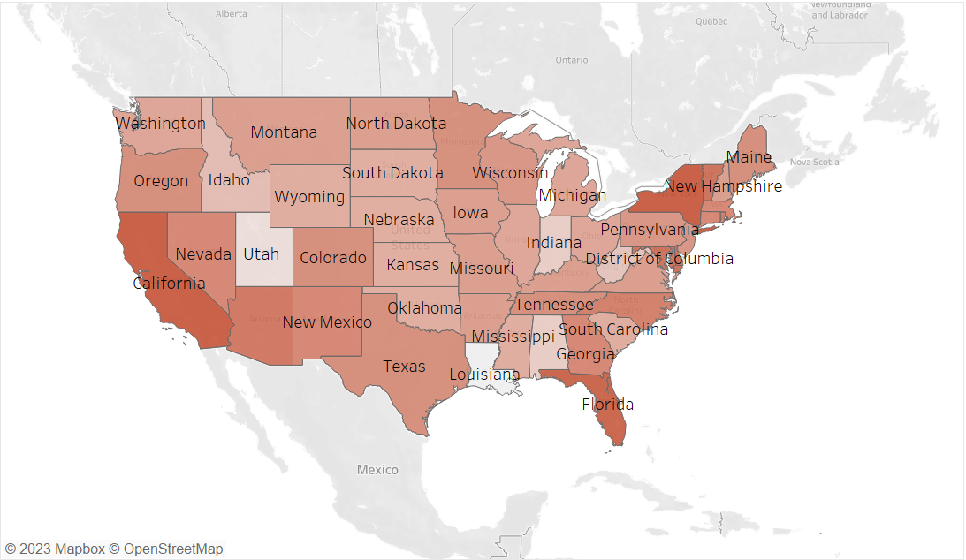
Pay Gap in the US: Earnings' ratio across States
Highest pay gap in states like California, Florida, New York
Lowest in places like Utah and Louisiana
Pay percentage ration in UK : 77%
Factors influencing :
Ration of Urban to Rural population.
State size (bigger have higher pay gap)
Cost of Living
Education and Industry
Labor Market Dynamics

Slide 6
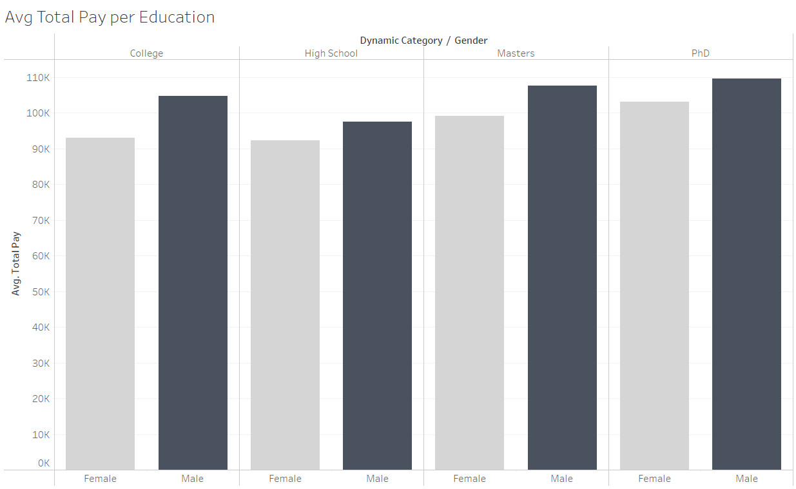
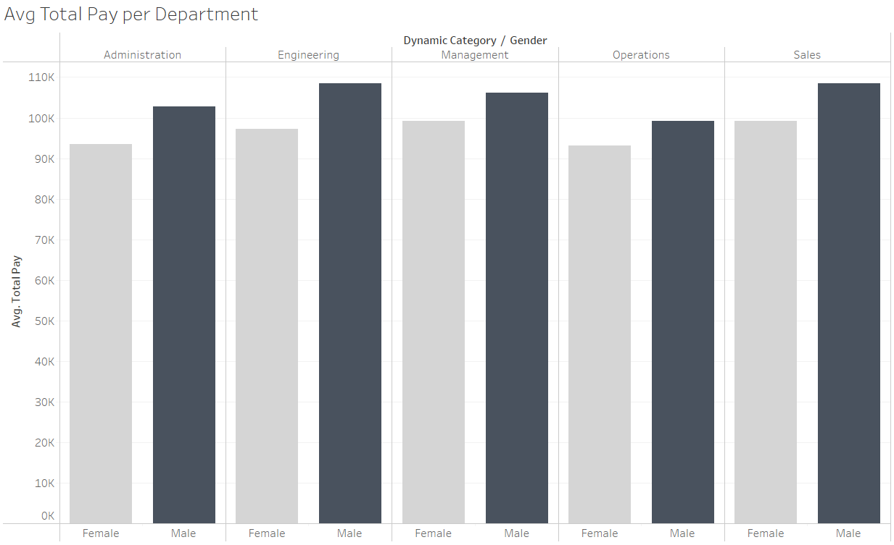
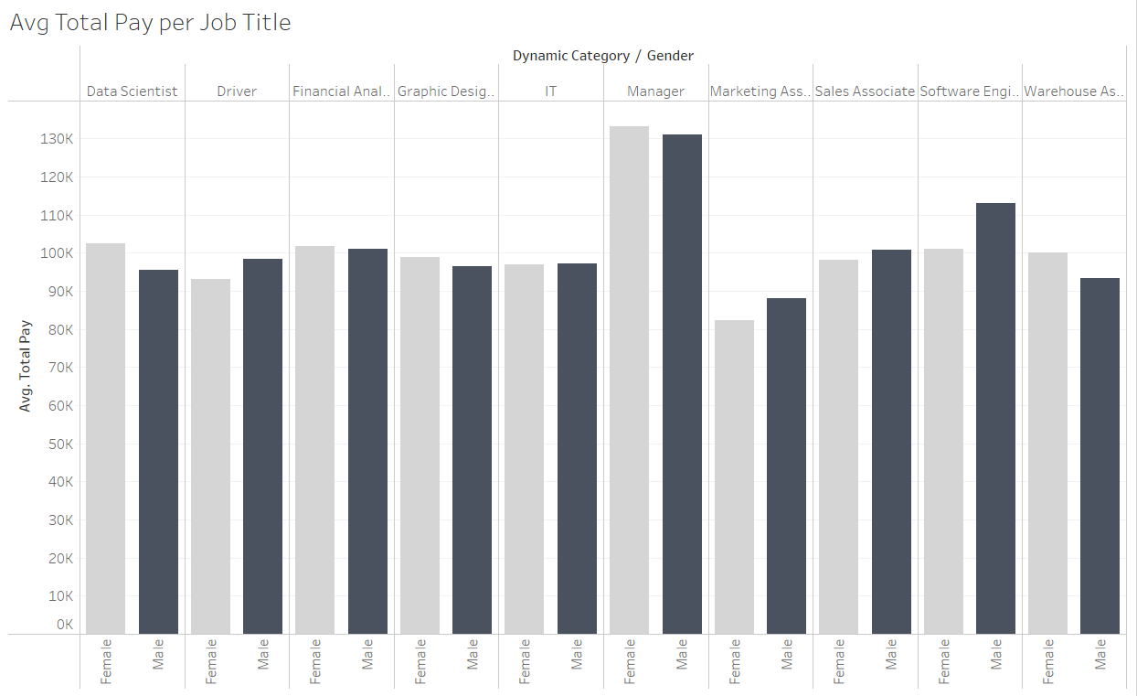
Avg Total Pay per Department/Education/Job Title
When we specifically look per Job Title, we can see cases where Avg Total Pay for Female is higher.

Slide 7
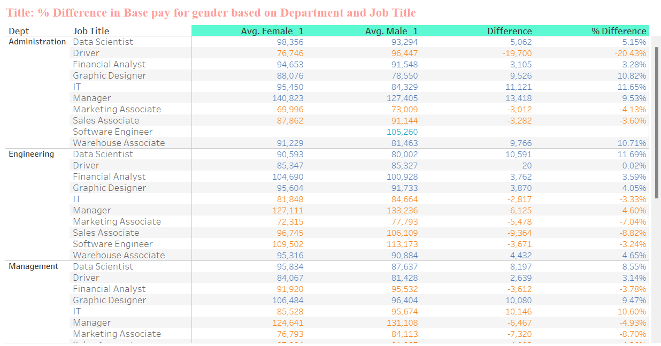
% Difference in Base pay for gender based on Department and Job Title
Dominant Pay Gap in Software Developer Role:
We observed that the pay gap is most dominant in the profession of Software Developers, with males leading in terms of higher salaries.
This suggests that within the Software Developer job title, there's a significant difference in average salaries between males and females, with males earning more.
Bidirectional Pay Gap:
We also noted that the pay gap is not unidirectional, indicating that it's not the case that males always earn more than females in every job title.
There are instances where females may earn more than males in certain job titles or departments.
Departments Catering Well to Females:
The positive observation highlights that some job titles or departments may have a pay structure that favours females over males.
This is an important point to consider, as it suggests that there may be gender equality in compensation in certain areas of organization.

Slide 8
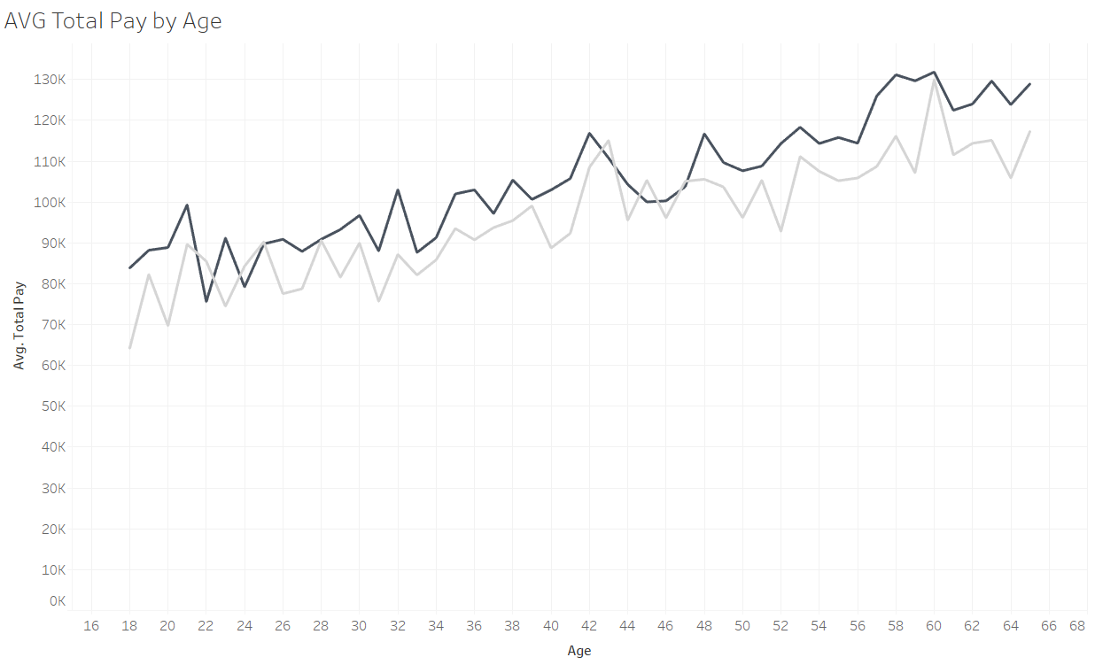
AVG Total Pay by Age
Increase in Total Pay follows the same slope in both genders. However, we still observe average values in female total pays.

Slide 9
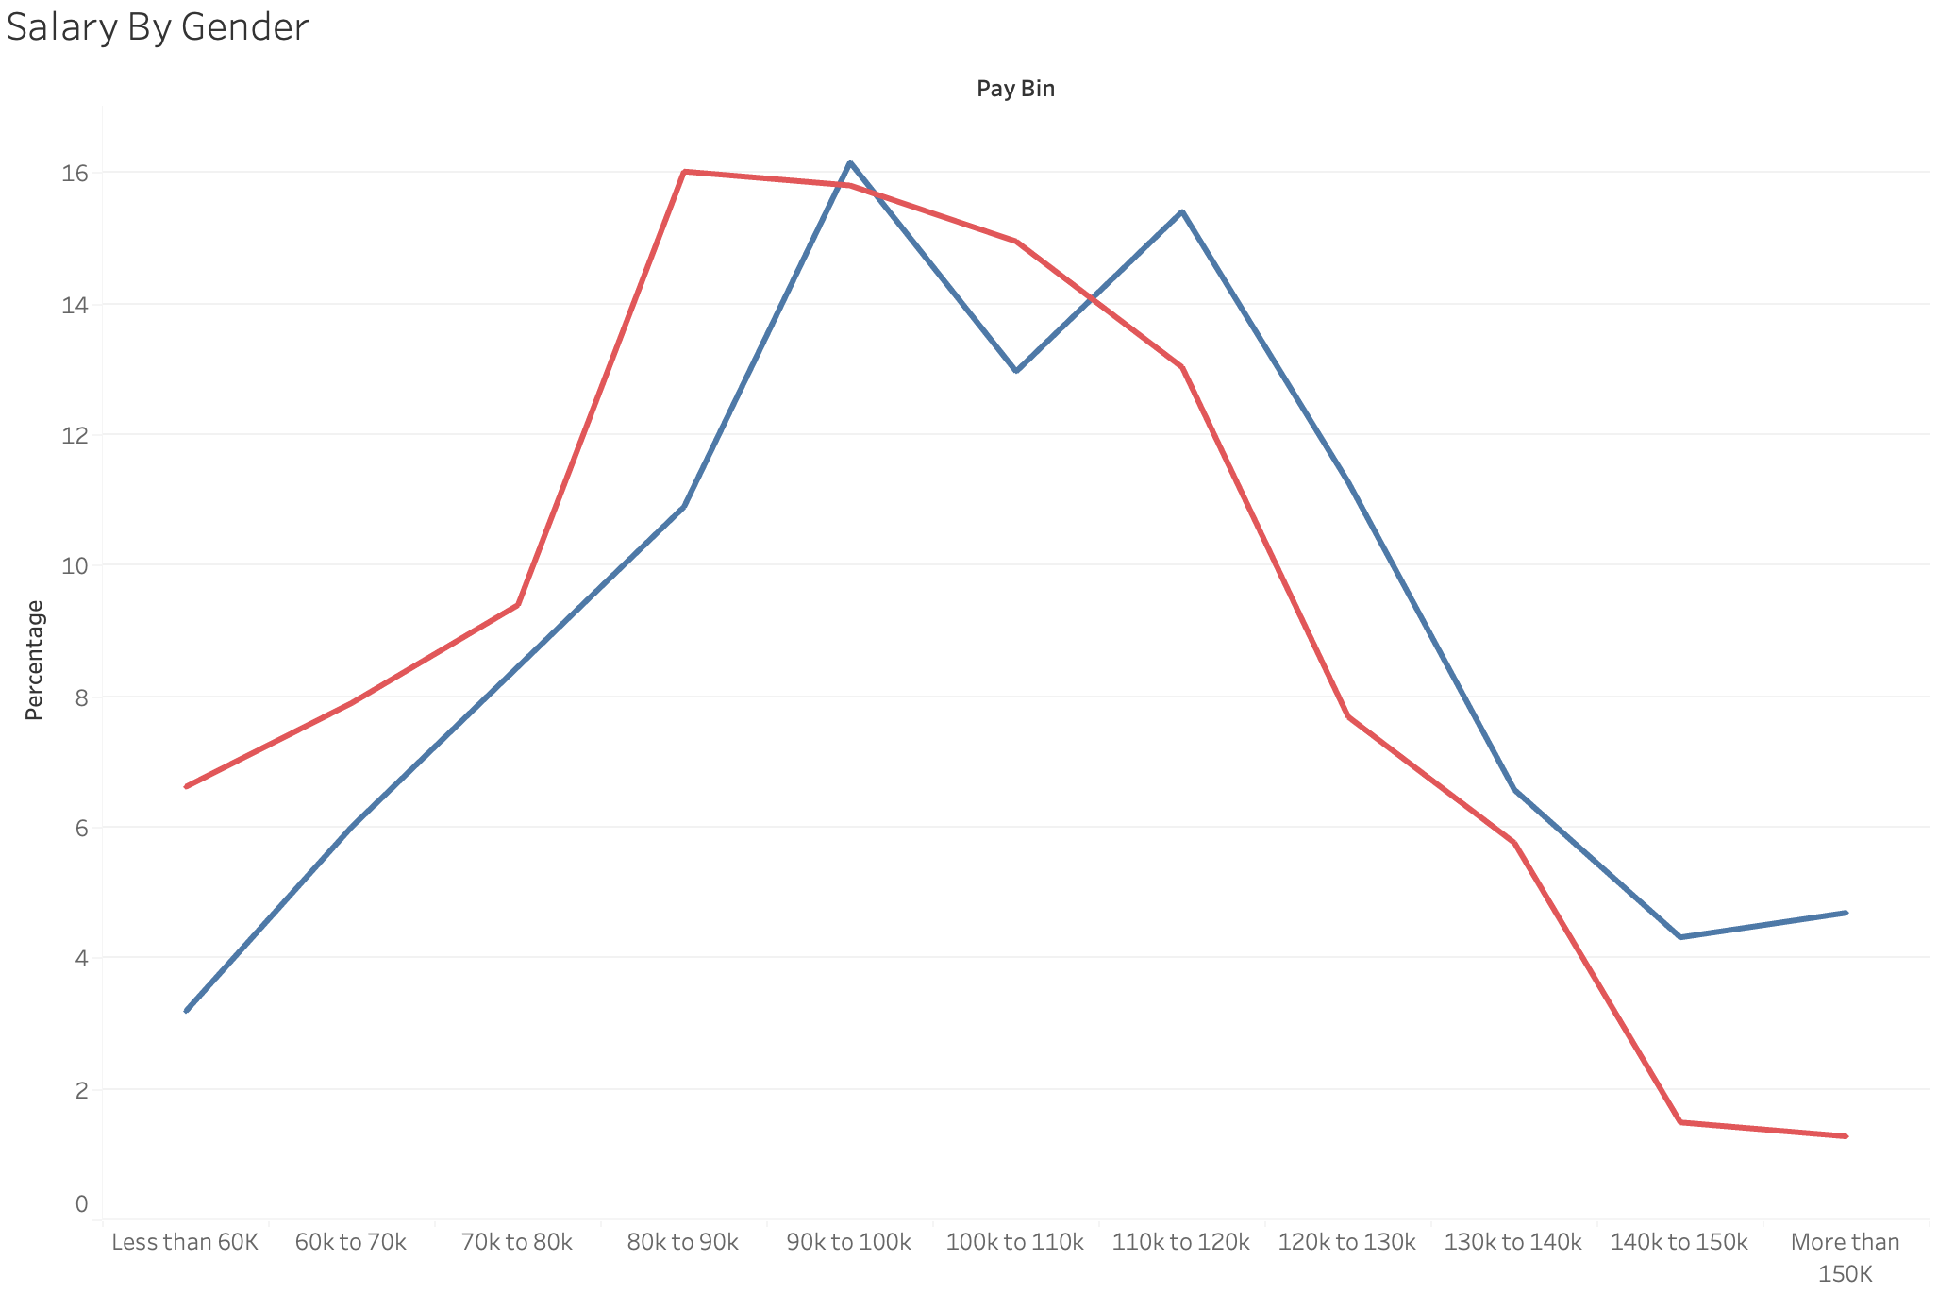
Female and Male pay in different Pay ranges
6.6% of females get paid below 60k, while only % of male get paid the same.
4.5 % of male get paid over 150K, while only 1.1 % for female.
Huge inclination for male on getting higher salary comparing with female.

Slide 10
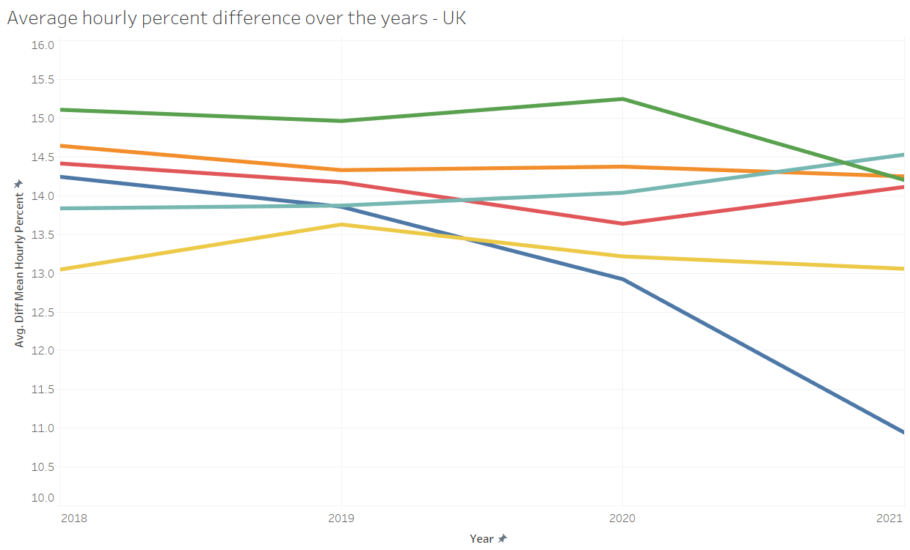
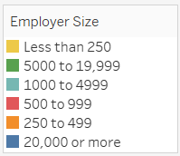
Average hourly percent difference over the years - UK
No matter the progress there is still positive percentage
Larger corporations show quicker improvement on reducing that percentage

Slide 11
Conclusion and Limitations
Introducing Gender Pay Gap
We have endeavored to visually represent a very prevalent aspect of our everyday life
In answer to the two questions posed at the beginning, we have tried to utilize different graphs to represent different aspects of those questions
However, there are certain limitations to this approach
The entire analysis is based on sampled data from certain specific sources, thus, limiting the insights .

Slide 12
Questions?

